Slide 1
VERIFICATION OF FORECASTS AND WARNINGS
– FACTS AND PROCEDURE
DR M MOHAPATRA
INDIA METEOROLOGICAL DEPARTMENT
MAUSAM BHAVAN, LODI ROAD, NEW DELHI-110003

Slide 2
PRESENTATION LAY OUT
INTRODUCTION
PRESENT PRACTICE
NEED FOR VERIFICATION
VERIFICATION PROCEDURE
EXAMPLE
CONCLUSIONS

Slide 3
INTRODUCTION
VARIOUS TYPES OF WARNINGS BEING PROVIDED SINCE THE INCEPTION OF IMD FOR DIFFERENT SPATIAL TEMPORAL SCALES.
A FEW ATTEMPTS HAVE BEEN MADE FOR QUANTITATIVE EVALUATION OF THESE WARNINGS
THE PRESENT PRACTICE OF VERIFICATION OF FORECASTS OF RAINFALL WHICH EXISTS FOR SUBDIVISIONAL RAINFALL FORECAST DATES BACK TO 1962.
IT IS VERY OLD, SUBJECTIVE AND NEED REVISION BASED ON THE AVAILABLE ADVANCED FORECAST VERIFICATION TECHNIQUES

Slide 4
PRESENT PRACTICE
(SUB-DIVISIONAL RAINFALL FORECAST)
SUB-DIVISION-WISE RAINFALL FORECAST (BOTH SPATIAL AND INTENSITY DISTRIBUTION)
CONTINGENCY TABLES ARE PREPARED, BUT SKILL SCORES ARE NOT CALCULATED.
SPATIAL DISTRIBUTION: FORECAST CONSIDERED AS
CORRECT : IF WITHIN ONE STAGE
PARTIALLY CORRECT : IF WITHIN TWO STAGES
WRONG : IF MORE THAN TWO STAGES

Slide 5
PRESENT PRACTICE
(QUANTITATIVE PRECIPITATION FORECAST)
FORECAST ISSUED IN DIFFERENT RANGES FOR ANY RIVER CATCHMENT
VERIFIED BASED ON AREA WEIGHTED RAINFALL AND ARITHMETIC AVERAGE RAINFALL
PERCENTAGE OF FORECAST WITHIN THE RAINGE, OUT BY ONE STAGE AND OUT BY TWO STAGES OR MORE ARE CALCULATED.
NO OBJECTIVE VERIFICATION TO CALCULATE THE SKILL SCORE

Slide 6
PRESENT PRACTICE
(LOCAL FORECAST)
HIGHLY SUBJECTIVE
RAINFALL: FORECAST IS TAKEN AS CORRECT, IF ANY STATION WITHIN 50 NM RECORDS RAINFALL. IT IS PARTLY CORRECT, IF CB CLOUD DEVELOPS.
TEMPERATURE: TAKEN CORRECT, IF WITHIN 1 DEG. PARTIALLY CORRECT IF WITHIN 2 DEG. WRONG OTHERWISE.
SIGNIFICANT WEATHER : FORECAST OF THUNDERSTORM IS TAKEN AS CORRECT IF CB DEVELOPS.
MONTHLY PERCENTAGE OF CORRECT, PARTIALLY CORRECT AND WRONG FORECASTS ARE CALCULATED
IT DOES NOT GIVE ANY QUANTITATIVE MEASURE OF THE SKILL OF THE FORECASTER

Slide 7
PRESENT PRACTICE
(CYCLONE TRACK AND INTENSITY FORECAST ERROR)
NO VERIFICATION OF OPERATIONAL CYCLONE FORECAST
ONLY CLIPER AND QLM MODEL FORECASTS FOR TRACK OF THE SYSTEM ARE VERIFIED.
VECTOR ERROR, DISTANCE ERROR AND ANGULAR DEVIATIONS ARE CALCULATED FOR QLM. DISTANCE ERROR IS CALCULATED FOR CLIPER MODEL. ALL THESE ERRORS ARE CALCULATED FOR VARIOUS FORECAST PERIOD LIKE 12, 24, 36 AND 48 HRS FORECAST ETC.
LANDFALL FORECASTS ARE ALSO NOT VERIFIED
HOWEVER, CWD HAS STARTED VERIFYING THE ABOVE BASED ON AVAILABLE PAST DATA

Slide 8
PRESENT PRACTICE
(FORECAST OF OTHER EXTREME WEATHER EVENTS)
HEAVY RAINFALL
HEAT WAVE
COLD WAVE
THUNDERSQUALL ETC

Slide 9
PRESENT PRACTICE
(AVIATION WEATHER FORECAST)
THE FOLLOWING ARE VERIFIED BASED ON SAMPLE SURVEY
TREND
TAFOR
LOFOR
ARFOR
ROFOR
AERODROME WARNING
THERE IS NO OBJECTIVE VERIFICATION OF AVIATION WEATHER FORECASTS

Slide 10
PRESENT PRACTICE
(NWP MODEL FORECAST)
NO SYSTEMATIC VERIFICATION OF NWP MODEL FORECAST LIKE
GENESIS, INTENSIFICATION/DECAY, MOVEMENT AND LANDFALL OF CYCLONIC DISTURBANCES
DIFFERENT METEOROLOGICAL FIELDS LIKE TEMPERATURE, PRESSURE, RAINFALL ETC

Slide 11
NEED FOR VERIFICATION
MONITORING OF VALUE AND QUALITY OF FORECAST
COMPARISON OF QUALITY OF DIFFERENT FORECAST SYSTEMS AND TO FIND OUT THE BETTER ONE
GOODNESS OF FORECAST IS DISTINGUISHED BY
CONSISTENCY (DEGREE TO WHICH THE FORECAST CORRESPONDS TO THE FORECASTER’S BEST JUDGEMENT ABOUT THE SITUATION),
VALUE (THE DEGREE TO WHICH THE FORECAST HELPS A DECISION MAKER TO REALIZE SOME INCREMENTAL ECONOMIC AND OTHER BENEFITS AND
QUALITY (DEGREE TO WHICH THE FORECAST CORRESPONDS TO WHAT ACTUALLY HAPPENED
THERE ARE NINE ASPECTS CONTRIBUTING TO QUALITY OF FORECAST. THESE INCLUDE BIAS, RESOLUTION, ACCURACY, SKILL, DISCRIMINATION AND UNCERTAINTY

Slide 12
TYPES OF FORECAST
DETERMINISTIC FORECAST (OCCURRENCE/NON-OCCURRENCE OF AN EVENT LIKE HEAVY RAINFALL)
PROBABILISTIC FORECAST
(E.G. PROBABILITY OF PRECIPITATION AND ENSEMBLE FORECAST)
QUALITATIVE FORECAST
(LIKE 5 DAY OUTLOOK)

Slide 13
METRICS AND METHODS
CONTINOUS VARIABLE
(LIKE PRECIPITATION, WIND SPEED AND DIRECTION, TEMPERATURE, DEW POINT, RELATIVE HUMIDITY)
FOLLOWING METRICS CAN BE COMPUTED FOR THE ABOVE
MEAN FORECAST AND OBSERVED VALUES
MEDIAN FORECAST AND OBSERVED VALUES
STANDARD DEVIATION OF FORECAST AND OBSERVED VALUES
MEAN ERROR
MEAN ABSOLUTE ERROR
ROOT MEAN SQUARE ERROR
CORRELATION COEFFICIENT

Slide 14
DICHOTOMOUS (YES/NO) FORECASTS
A DICHOTOMOUS FORECAST SAYS, "YES, AN EVENT WILL HAPPEN", OR "NO, THE EVENT WILL NOT HAPPEN". RAIN AND FOG PREDICTION ARE COMMON EXAMPLES OF YES/NO FORECASTS. FOR SOME APPLICATIONS A THRESHOLD MAY BE SPECIFIED TO SEPARATE "YES" AND "NO", FOR EXAMPLE, HEAVY RAINFALL.
TO VERIFY THIS TYPE OF FORECAST WE START WITH A CONTINGENCY TABLE THAT SHOWS THE FREQUENCY OF "YES" AND "NO" FORECASTS AND OCCURRENCES. THE FOUR COMBINATIONS OF FORECASTS (YES OR NO) AND OBSERVATIONS (YES OR NO), CALLED THE JOINT DISTRIBUTION, ARE:
HIT - EVENT FORECAST TO OCCUR, AND DID OCCUR
MISS - EVENT FORECAST NOT TO OCCUR, BUT DID OCCUR
FALSE ALARM - EVENT FORECAST TO OCCUR, BUT DID NOT OCCUR
CORRECT NEGATIVE - EVENT FORECAST NOT TO OCCUR, AND DID NOT OCCUR

Slide 15
CONTINGENCY TABLE
 |  |  | OBSERVED
 |  | YES | NO | TOTAL
FORECAST | YES | HITS | FALSE ALARMS | FORECAST YES
 | NO | MISSES | CORRECT NEGATIVES | FORECAST NO
TOTAL |  | OBSERVED YES | OBSERVED NO
A PERFECT FORECAST SYSTEM WOULD PRODUCE ONLY HITS AND CORRECT NEGATIVES, AND NO MISSES OR FALSE ALARMS.

Slide 16

DETERMINISTIC FORECAST
PROBABILITY OF DETECTION (POD) = A/ (A+B)
= HITS / (HITS + MISSES)
FALSE ALARM RATE (FAR) = C/ (C+A)
= FALSE ALARMS/ (HITS + FALSE ALARMS
MISSING RATE (MR) = B/ (B+A)
=MISSES/ (HITS + MISSES)
CORRECT NON-OCCURRENCE (C-NON) =D/(C+D)
= CORRECT NEGATIVE / (FALSE ALARMS + CORRECT NEGATIVES
CRITICAL SUCCESS INDEX (CSI) = THREAT SCORE = A/ (A+B+C)
= HITS / (HITS + MISSES + FALSE ALARMS
BIAS FOR OCCURRENCE (BIAS)= (A+C)/(A+B)
= (HITS + FALSE ALARMS) / (HITS + MISSES)
PERCENTAGE CORRECT (PC) = (A+D)/(A+B+C+D)*100 = HIT RATE * 100
= ((HITS + CORRECT NEGATIVES) / TOTAL) * 100
HEIDKE SKILL SCORE (HSS) = 2(AD-BC)/ ((B²+C²+2AD+(B+C)(A+D))
OBSERVED | FORECAST
 | YES | NO
YES | A | B
NO | C | D

Slide 17
VERIFICATION SCORES
PARAMETER RANGE PERFECT SCORE
PROBABILITY OF DETECTION (POD) 0 – 1 1
FALSE ALARM RATE (FAR) 0 – 1 0
MISSING RATE (MR) 0 – 1 0
CORRECT NON-OCCURRENCE (C-NON) 0 – 1 1
CRITICAL SUCCESS INDEX (CSI) 0 – 1 1
BIAS FOR OCCURRENCE (BIAS) 0 – INFINITY 1
PERCENTAGE CORRECT (PC) 0 – 100 100
HEIDKE SKILL SCORE (HSS) MINUS INFINITY – 1 1

Slide 18
VERIFICATION OF CONTINUOUS VARIABLE AS DICHOTOMOUS VARIABLE
FORECAST OF CONTINUOUS VARIABLE CAN BE TREATED AS DICHOTOMOUS VARIABLE IN WHICH CASE SEVERAL INTENSITY THRESHOLDS SHOULD BE USED.
EXAMPLE : WIND SPEED EXCEEDING 60 KMPH, RAINFALL EXCEEDING 64.4 MM, TEMPERATURE EXCEEDING 40 DEG C ETC.
COLD WAVE/ HEAT WAVE WARNING CAN BE VERIFIED LIKE HEAVY RAINFALL WARNING
FOR A SUB-DOIVISION. CONSIDERING OCCURRENCE/NON OCCURRENCE OF COLD WAVE/ HEAT WAVE IN THE SUB-DIVISION AND USING 2x2 CINTINGENCY TABLE

Slide 19
CATEGORICAL FORECAST
Observed range (mm) | Forecast range (mm)
 | 0 | 1-10 | 11-25 | 26-50 | 51-100 | >100 | Total
0 | a | b | c | d | e | f | A
1-10 | g | h | i | j | k | l | B
11-25 | m | n | o | p | q | r | C
26-50 | s | t | u | v | w | x | D
51-100 | y | z | aa | ab | ac | ad | E
>100 | ae | af | ag | ah | ai | aj | F
Total | G | H | I | J | K | L | T
PC = ((a+h+o+v+ac+aj)/T)*100
CSI = a/(A+G-a), h/(B+H-h), o/(C+I-o), v/(D+J-v), ac/(E+K-ac), aj/(F+L-aj)
HSS=(a+h+o+v+ac+aj)-(AG+BH+CI+DJ+EK+FL)/T)/(T-(AG+BH+CI+DJ+EK+FL)/T)
The POD, FAR, MR , CSI, BIAS, PC, TSS and HSS etc for each category can be calculated by reducing the above 6x6 contigency Table into yes/no forecast 2x2 contingency Table as discussed in previous slide.

Slide 20
SPATIAL DISTRIBUTION OF THE SUBDIVISIONAL RAINFALL
Spatial distribution | Area of the subdivision getting rainfall
Dry | No rain in the subdivision
Mainly dry | < 2.5 mm reported in any station in the subdivision
Isolated | 25% or less
Scattered | 26% - 50%
Fairly widespread | 51% - 75%
Widespread | 76% - 100%
The forecast of spatial distribution of rainfall can be verified using 5x5 contingency.

Slide 21
VERIFICATION OF CATEGORICAL FORECAST (QPF)
Observed Range | Forecast range
 | Dry | Isol | Scatt | Fairly widespread | Widespread | Total
Dry | a | b | c | d | e | J
Isolated | f | g | h | i | j | K
Scattered | k | l | m | n | o | L
Fairly widespread | p | q | r | s | t | M
Wide spread | u | v | w | x | y | N
Total | O | P | Q | R | S | T
PC = ((a+g+m+s+y)/T)*100
CSI = a/(J+O-a), g/(K+P-g), m/(L+Q-m), s/(M+R-s), y/(N+S-y)
HSS= (a+g+m+s+y-(JO+KP+LQ+MR+NS)/T)/ (T-(JO+KP+LQ+MR+NS)/T)

Slide 22
CONVERSION OF CATEGORICAL FORECAST INTO DETERMINISTIC FORECAST
The POD, FAR, MR , CSI, BIAS, PC, TSS and HSS etc for each category can be calculated by reducing the above 6x6 contigency Table into yes/no forecast 2x2 contingency

Slide 23
INTENSITY OF RAINFALL
Intensity of rainfall | Amount of rainfall
Dry | No rain in the subdivision
Very light | < 2.5 mm
Light | 2.5 – 7.4 mm
Moderate | 7.5 – 24.4 mm
Rather heavy | 24.5 – 64.4 mm
Heavy | 64.5 mm – 124.4 mm
Very heavy | 124.5 mm – 244.4 mm
Extremely heavy | 245 mm or more
Exceptionally heavy | It the rainfall is higher than or nearer to the earlier record over the station. However the rainfall should be 13 cm or more

Slide 24
VERIFICATION OF INTENSITY OF RAINFALL- DISTRICTWISE RAINFALL
Observed range (mm) | Forecast range (mm)
 | Light | Moderate | Rather heavy | Heavy | Very heavy | Extremely heavy | Total
Light | a | b | c | d | e | f | A
Moderate | g | h | i | j | k | l | B
Rather heavy | m | n | o | p | q | r | C
Heavy | s | t | u | v | w | x | D
Very heavy | y | z | aa | ab | ac | ad | E
Extremely heavy | ae | af | ag | ah | ai | aj | F
Total | G | H | I | J | K | L | T
PC = ((a+h+o+v+ac+aj)/T)*100
CSI = a/(A+G-a), h/(B+H-h), o/(C+I-o), v/(D+J-v), ac/(E+K-ac), aj/(F+L-aj)
HSS=(a+h+o+v+ac+aj)-(AG+BH+CI+DJ+EK+FL)/T)/(T-( AG+BH+CI+DJ+EK+FL)/T)
The POD, FAR, MR , CSI, BIAS, PC, TSS and HSS etc for each category can be calculated by reducing the above 6x6 contigency Table into yes/no forecast 2x2 contingency

Slide 25
LOCAL FORECAST VERIFICATION
VERIFICATION OF TEMPERATURE FORECAST
CATEGORY CHANGE
NO SIGNIFICANT CHANGE +1 TO -1 º C
RISE/FALL 2 º C
APPRECIABLE RISE/ FALL 3-4 º C
MARKEDLY RISE/ FALL 5-7 º C
CATEGORY DEPARTURE FROM NORMAL
NORMAL -1 TO +1º C
BELOW/ ABOVE NORMAL -2/ +2 º C
APPRECIABLY BELOW/ ABOVE NORMAL (-3 TO -4 º C)/ 3-4 º C
MARKEDLY BELOW/ ABOVE NORMAL -5 º C OR LESS/ +5 º C OR MORE
IN CASE OF ACTUAL TEMPERATURE FORECAST OVER A DISTRICT, MEAN ERROR, RMS ERROR, CORRELATION COEFFICIENTS ETC CAN BE CALCULATED FOR VERIFICATION PURPOSE.

Slide 26
LOCAL FORECAST VERIFICATION
VERIFICATION OF CLOUD COVERAGE
CATEGORY CLOUD AMOUNT
MAINLY CLEAR SKY 2 OKTA OR LESS
PARTLY CLOUDY SKY 3-4 OKTA
MAINLY CLOUDY SKY 5-7 OKTA
OVERCAST SKY 8 OKTA
A 4X4 CONTINGENCY TABLE CAN BE PREPARED TO CALCULATE PERCENTAGE CORRECT, CRITICAL SUCCESS INDEX AND HEIDKE SKILL SCORE ETC AS GIVEN IN NEXT SLIDE

Slide 27
LOCAL FORECAST VERIFICATION
VERIFICATION OF CLOUD COVERAGE
Observed Range | Forecast range
 | MAINLY CLEAR | PARTLY CLOUDY | MAINLY CLOUDY | OVER CAST | Total
MAINLY CLEAR | a | b | c | d | J
PARTLY CLOUDY | f | g | h | i | K
MAINLY CLOUDY | k | l | m | n | L
OVERCAST | p | q | r | s | M
Total | O | P | Q | R | T
PC = ((a+g+m+s)/T)*100
CSI = a/(J+O-a), g/(K+P-g), m/(L+Q-m), s/(M+R-s),
HSS= (a+g+m+s-(JO+KP+LQ+MR)/T)/ (T-(JO+KP+LQ+MR)/T)

Slide 28
VERIFICATION OF CYCLONE WARNING
OPERATIONAL CYCLONE WARNINGS ISSUED BY IMD ARE NOT VERIFIED AT PRESENT
QLM TRACK ERRORS ARE VERIFIED BY CALCULATING THE VECTOR ERROR IN KM.
VECTORS ERRORS CAN BE CALCULATED FOT THE FOR TRACK FORECAST OF CYCLONE DISTURBANCES ISSUED BY IMD
LANDFALL POINT & TIME ERRORS ALSO CAN BE CALCULATED. CWD HAS ALREADY CALCULATED LANDFALL ERROR FOR THE CYCLONES IN LAST 10 YEARS.

Slide 29
VERIFICATION OF OUTLOOK
OUTLOOK ISSUED IN THE BULLETIN IS QUALITATIVE IN NATURE
IT CAN BE VERIFIED BY CONVERTING INTO QUANTITATIVE OUTLOOK
ACTUAL OUTLOOK
EX: INCREASE IN RAINFALL ACTIVITY OVER EXTREME SOUTH PENINSULA
CONVERTED OUTLOOK
REGION : KERALA, TAMILNADU & PUDUCHERRY, SOUTH COASTAL ANDHRA PRADESH, RAYALASEEMA AND SOUTH INTERIOR
KARNATAKA
FORECAST` DISTRIBUTION OUTLOOK DISTRIBUTION
ISOLATED SCATTERED OR MORE
SCATTERED FAIRLY WIDESPREAD OR MORE
FORECAST INTENSITY OUTLOOK INTENSITY
LIGHT TO MODERATE MODERATE TO RATHER HEAVY MODERATE TO RATHER HEAVY ISOLATED HEAVY
HEAVY SCATTERED HEAVY TO VERY HEAVY

Slide 30
DIAGNOSTIC VERIFICATION METHODS
THIS FORECAST VERIFICATION SYSTEM INCLUDES VARIOUS SIMPLE VISUAL METHODS FOR COMPARING FORECASTS WITH OBSERVATIONS
MAPPED FORECASTS AND OBSERVATIONS
TIME SERIES OF FORECASTS AND OBSERVATIONS AT SELECTED SITES
SCATTER PLOTS
QUANTILE – QUANTILE PLOTS

Slide 31
VERIFICATION OF NWP MODELS
NWP MODELS CAN BE VERIFIED FOLLOWING STANDARD PROCEDURES AS ADOPTED IN VARIOUS COUNTRIES AND AVAILABLE IN LITERATURE
FOLLOWING PARAMETERS MAY BE VERIFIED
  GENESIS, INTENSIFICATION/DECAY, MOVEMENT AND LANDFALL OF SYNOPTIC DISTURBANCES
  RAINFALL DUE TO THE ABOVE SYSTEMS
  LOCATION SPECIFIC FORECAST AVAILABLE FROM MODELS CAN BE VERIFIED USING 2X2 CONTINGENCY TABLE

Slide 32
AN EXAMPLE
VERIFICATION OF HEAVY RAINFALL WARNING

Slide 33
OBJECTIVE
VERIFICATION OF HEAVY RAINFALL WARNING ISSUED BY NHAC, IMD FOR VARIOUS METEOROLOGICAL SUB-DIVISIONS DURING SUMMER MONSOON SEASON
ANALYSIS OF RESULTS FOR IMPROVEMENT IN FORECAST SKILL
VERIFICATION OF CONTRIBUTION OF NWP MODELS GUIDANCE AND ITS LIMITATION IN HEAVY RAINFALL WARNING

Slide 34
DATA AND METHODOLOGY
STATION RAINFALL OVER DIFFERENT MET-SUBDIVISIONS OF INDIA BASED ON DRMS SCHEME ARE CONSIDERED
HEAVY RAINFALL WARNINGS ISSUED BY NHAC, IMD AS MENTIONED IN SPECIAL DAILY WEATHER REPORT ARE COLLECTED
PERIOD : MONSOON SEASON (JUNE – SEPTEMBER) DURING 2002 – 2006
WARNINGS ARE VERIFIED BASED ON RAINFALL REALISED DURING NEXT 24 HOURS ENDING AT 0830 IST OF NEXT DAY
HEAVY RAINFALL IS SAID TO HAVE OCCURRED, IF AT LEAST ONE STATION IN THE SUB-DIVISION RECORDED 24 HRS CUMULATIVE RAINFALL OF 7 CM OR MORE AT 0830 HRS IST OF A DAY
WITH ABOVE ASSUMPTION, OCCURRENCE / NON-OCCURRENCE OF HEAVY RAINFALL IS A DICHOTOMOUS VARIABLE. HENCE 2X2 CONTINGENCY TABLE HAS BEEN PREPARED FOR THE PURPOSE OF VERIFICATION

Slide 35
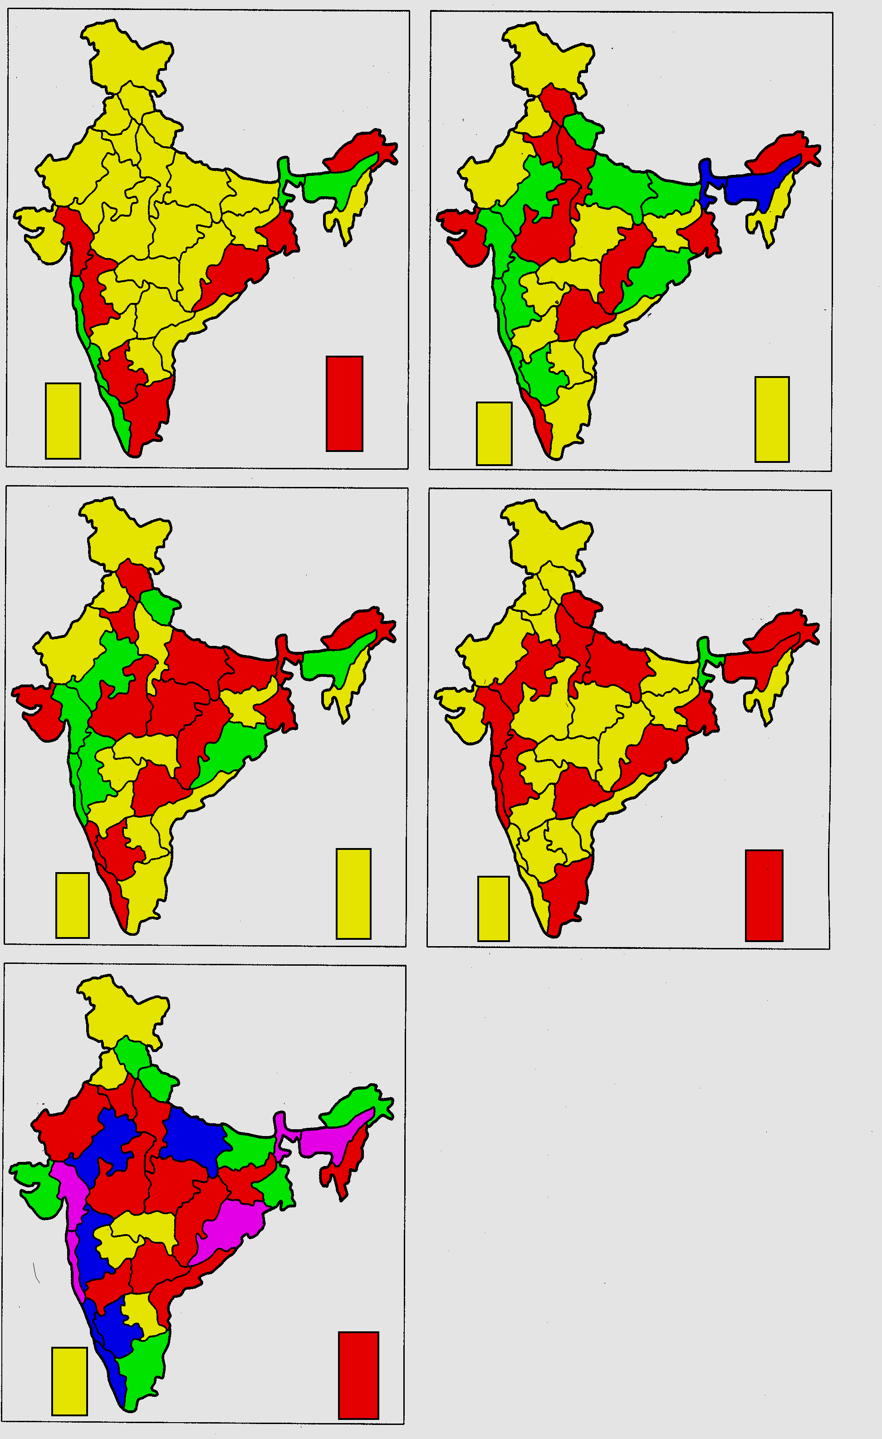
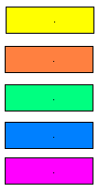
MEAN FREQUENCY OF HEAVY RAINFALL
FREQUENCY IS HIGHER OVER WEST COAST, ORISSA AND ASSAM & MEGHALAYA DURING JULY, AUG AND SEASON
FREQUENCY IS LESS OVER SOUTHEAST PENINSULA, W RAJ, PUNJAB, HARYANA, J&K DURING ABOVE PERIOD
OROGRAPHY AND LOW PRESSURE SYSTEMS PLAYS DOMINANT ROLE ON FREQUENCY OF HEAVY RAINFALL
SOUTHEAST PENINSULA GETS MORE HEAVY RAIN DURING JUNE AND SEP
MONTHS SEASON
0-5 1-10
6-10 11-20
11-15 21-30
16-20 31-40
>40

Slide 36
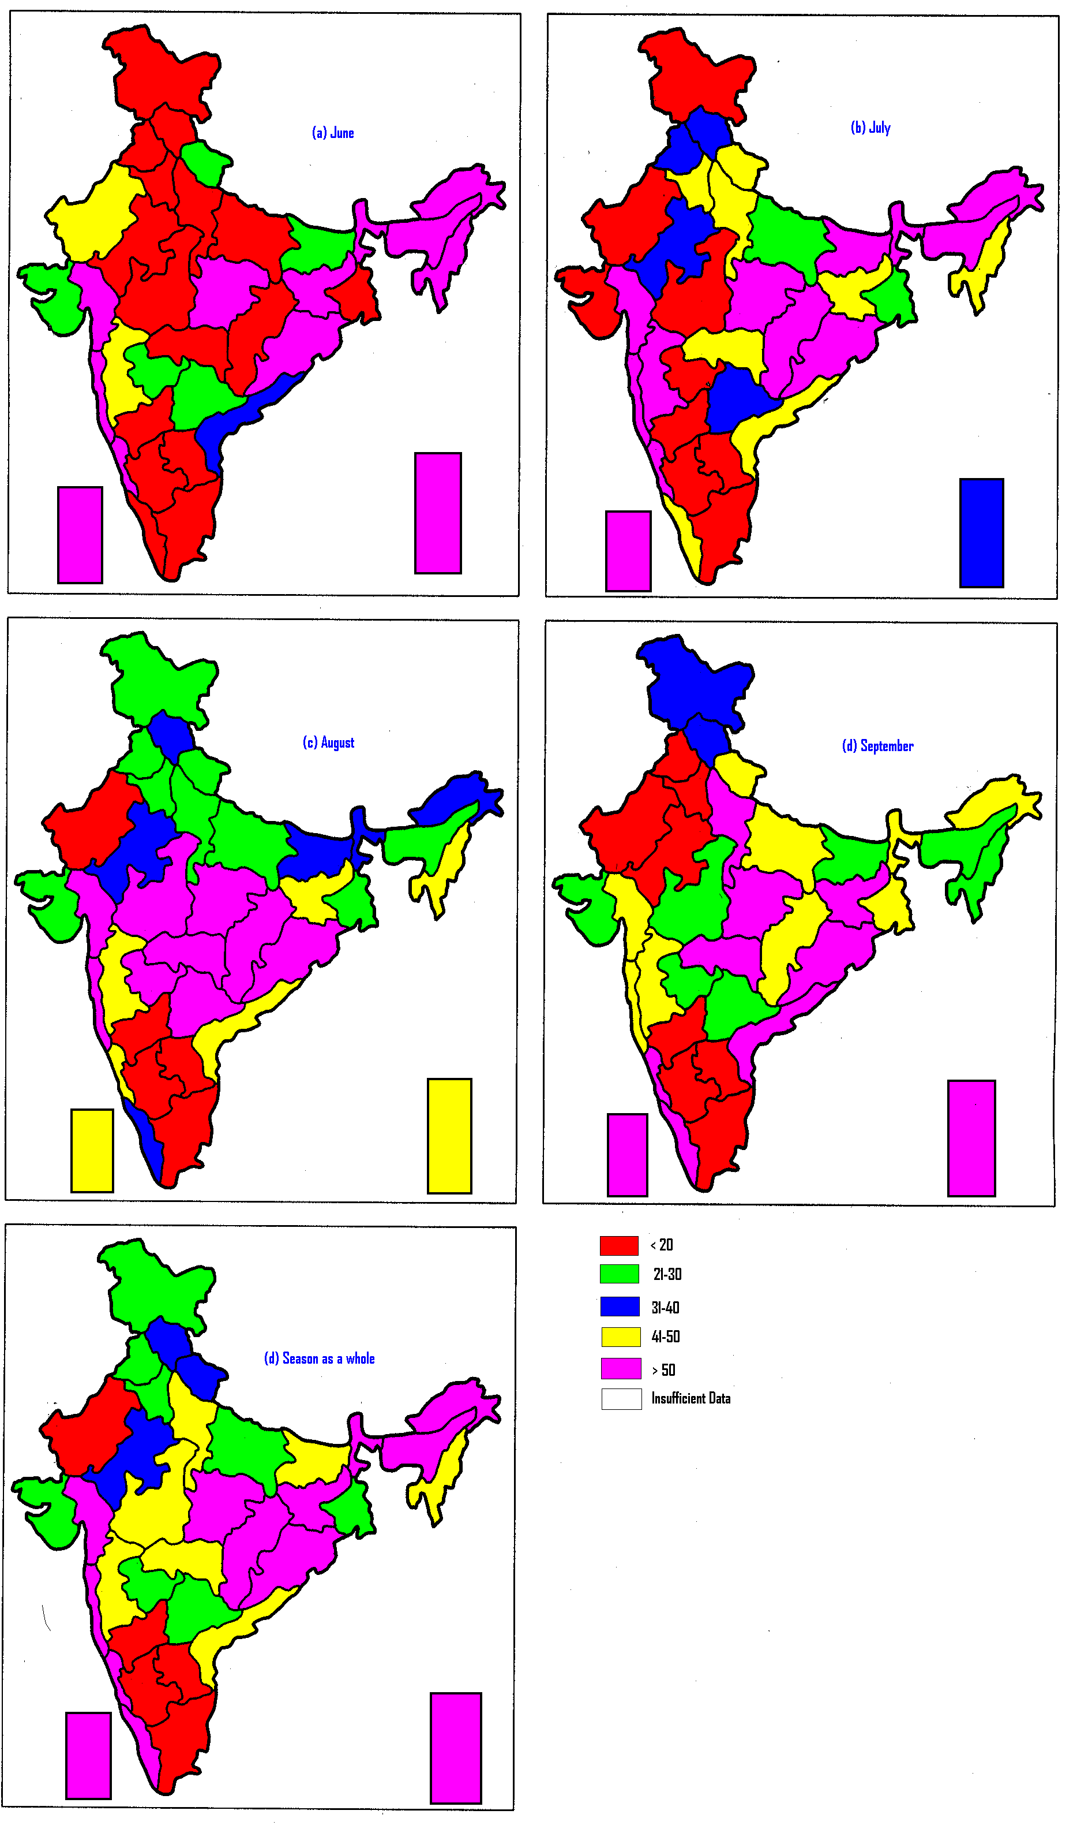
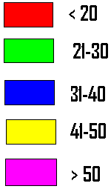
PROBABILITY OF DETECTION (%)
HIGHER OVER HIGHER RAINFALL REGION AND LESS OVER LESS RAINFALL REGION.
LESS IN JUNE FOLLOWED BY SEP AND HIGHER IN JULY AND AUG.
RELATIVELY HIGHER OVER CENTRAL INDIA (REGION OF MOVEMENT OF LPS

Slide 37
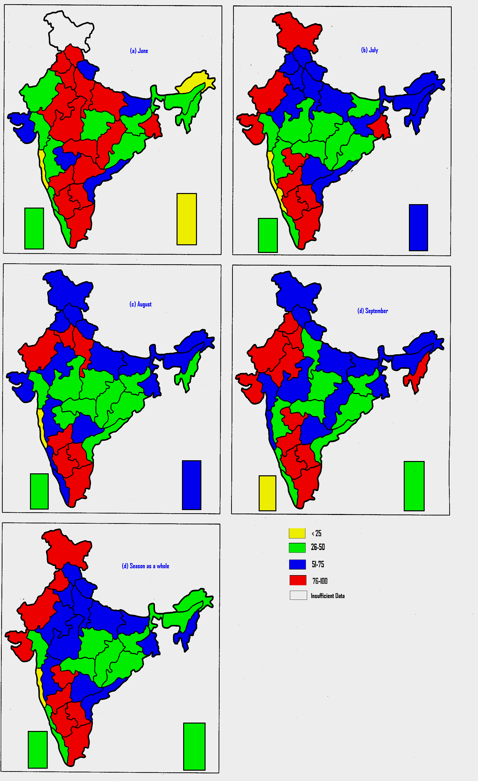
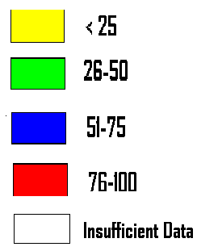
MISSING RATE (%)
LESS OVER HIGHER RAINFALL REGION AND MORE OVER LESS RAINFALL REGION.
HIGHER IN JUNE FOLLOWED BY SEP AND LESS IN JULY AND AUG.
RELATIVELY LESS OVER CENTRAL INDIA (REGION OF MOVEMENT OF LPS

Slide 38
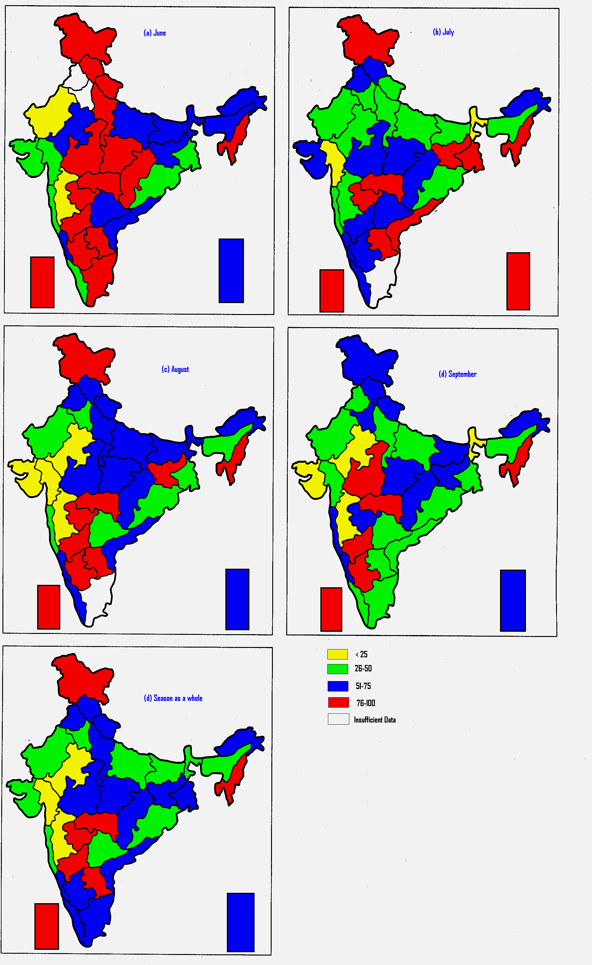
FALSE ALARM RATE (%)
LESS OVER MORE FREQUENT HEAVY RAINFALL
MORE OVER LESS FREQUENT HEAVY RAINFALL
HIGHER FAR IN JUNE AND LESS IN JULY AND AUG

Slide 39
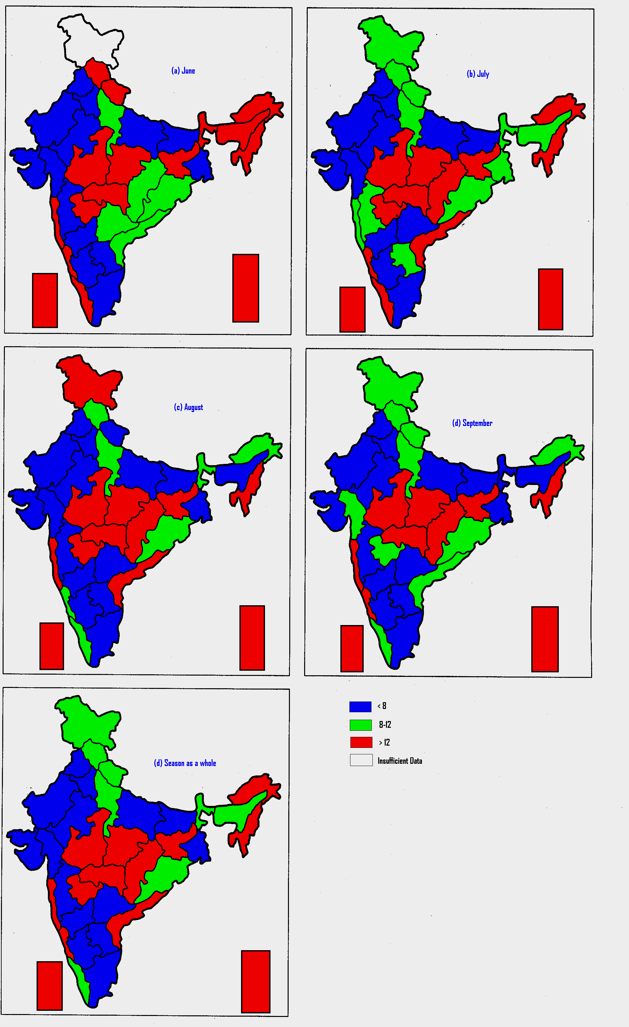
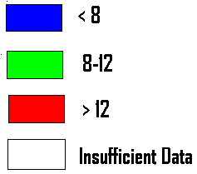
BIAS FOR OCCURRENCE
OVER WARNING : CENTRAL INDIA (REGION OF MOVEMENT OF LPS)
OVER WARNING : WEST COAST AR PR, NMMT, ISLANDS, COASTAL AP
UNDER WARNING : REGION WITH LESS HEAVY RAINFALL
( SOUTHEAST PENINSULA, RAJ, PUNJAB, HARYANA) ALSO OVER GUJ MADHYA MAHARASHTRA, UP AND BIHAR. MOSTLY DUE TO UNDERESTIMATION OF IMPACT OF REMNANTA OF LOW PRESSURE SYSTEMS AND SMALL SCALE CIRCULATION
< 0.8
0.8 – 1.2
> 1.2

Slide 40
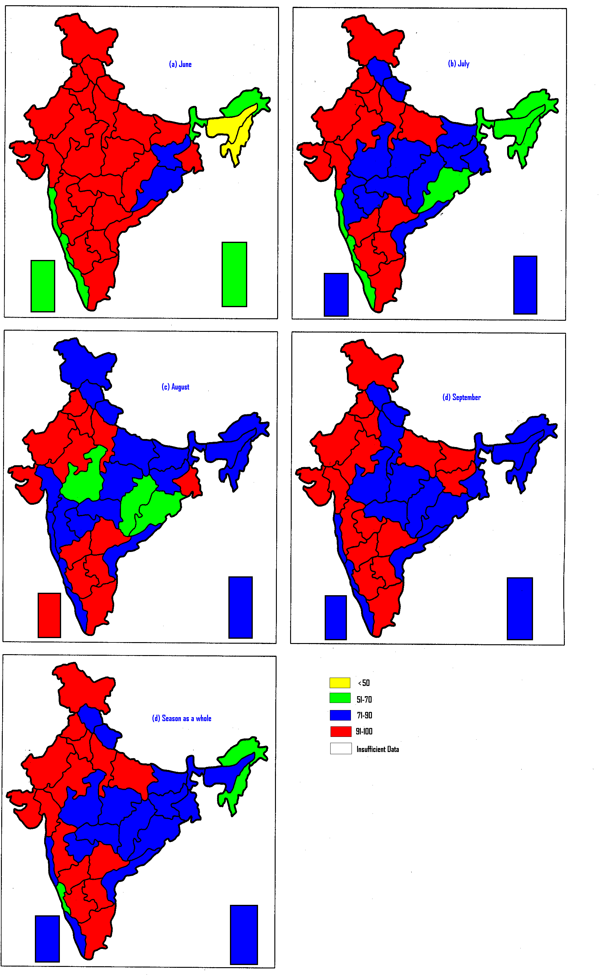
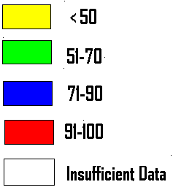
CORRECT NON-OCCURRENCE (%)
C-NON HIGHER OVER THE REGION WITH LESS HEAVY RAINFALL AND VICE VERSA DURING SEASON
C-NON IS LESS OVER CENTRAL INDIA (REGION OF MOVEMENT OF LPS)
LESS OVER NE STATES AND WEST COAST IN JUNE-JULY (MONTHS OF MORE FREQUENT HEAVY RAINFALL
IN GENERAL C-NON IS HIGHER IN JUNE-SEP THAN IN JULY-AUG

Slide 41
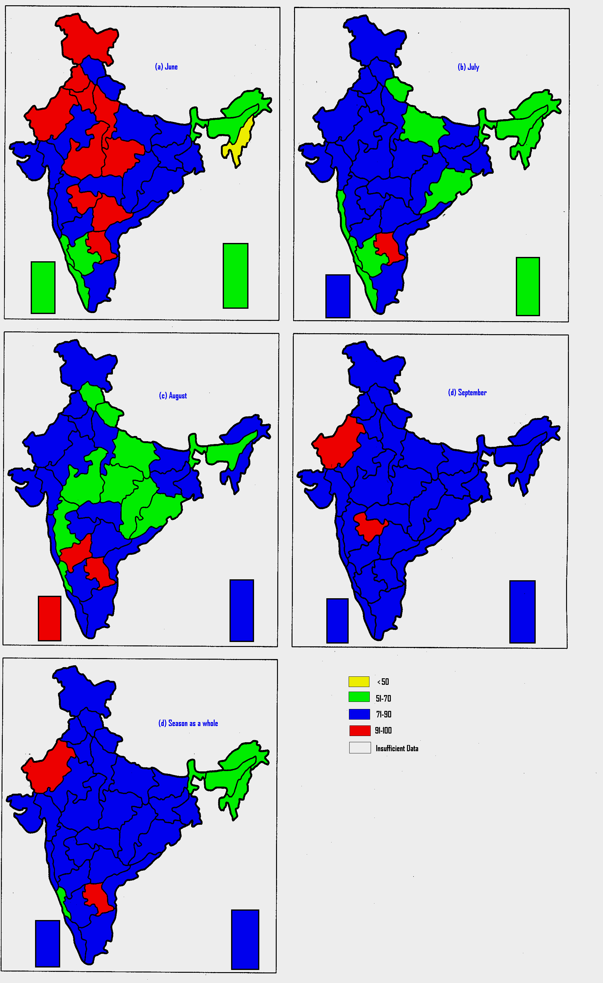
PERCENTAGE CORRECT
SEASONAL :
MORE THAN 70 % FOR MOST PARTS OF THE COUNTRY.
LESS OVER NE STATES, SHWB AND COASTAL KARNATAKA
LESS IN JUNE AND SEP AND HIGHER IN JULY AND AUG
LESS OVER CENTRAL INDIA (FROM ORISSA TO MP DURING AUGUST (MONTH OF MAXIMUM DEVELOPMENT OF LOW PRESSURE SYSTEMS.

Slide 42
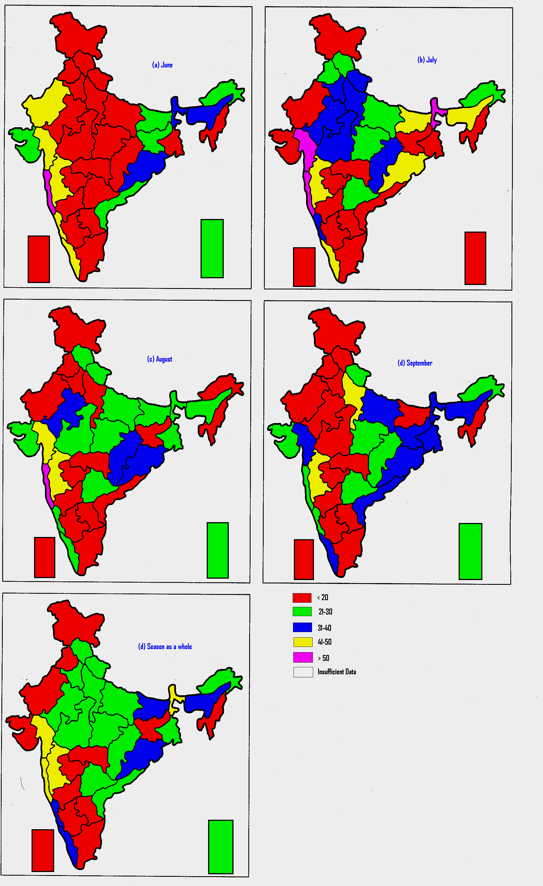
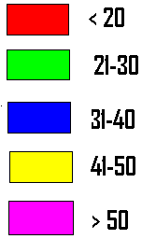
CRITICAL SUCCESS INDEX (%)
SEASONAL:
CSI HIGHER OVER BIHAR, SHWB, ASSAM & MEGHALAYA, ORISSA, WEST COAST AND MADHYA MAHARASHTRA LESS OVER SE PENINSULA AND NW INDIA
LISS OVER SE PENINSULA, NW INDIA, NMMT, JHARKHAND
LESS IN JUNE AND SEP AND HIGHER IN JULY AND AUG

Slide 43
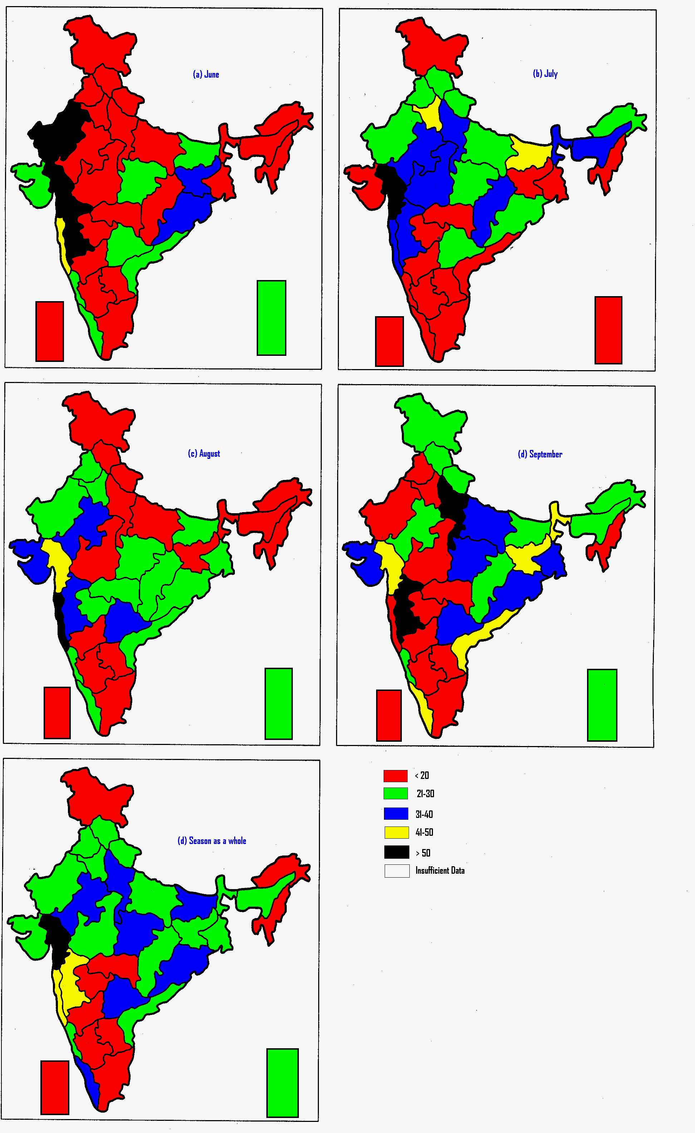
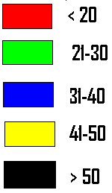
HEIDKE SKILL SCORE (%)
SEASONAL :
HSS IS HIGHER OVER JUJ, KON & GOA AND MADHYA MAGA
LESS OVER NMMT, AR PR, NW INDIA AND SE PENINSULA
HSS IS LESS IN JUNE FOLLOWED BY SEP AND HIGHER IN JULY AND AUG
HSS IS RELATIVELY HIGHER OVER CENTRAL INDIA (FROM ORISS TO GUJARAT IN DIFFERENT MONTHS AND SEASON

Slide 44
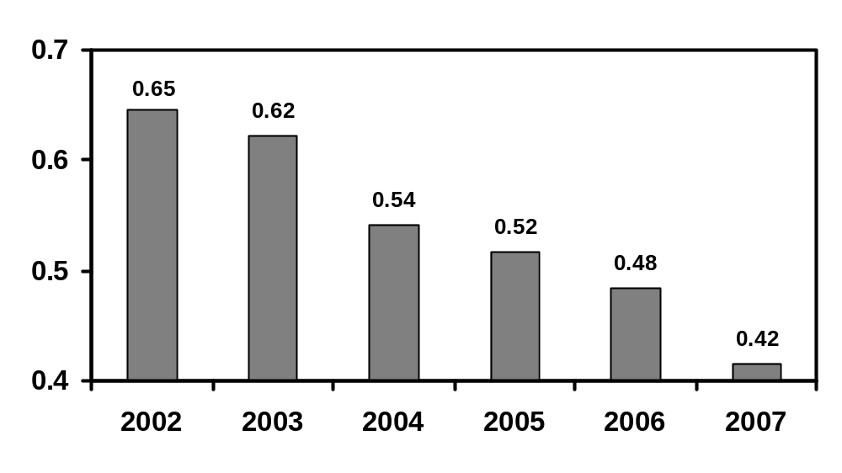
FAR

Slide 45
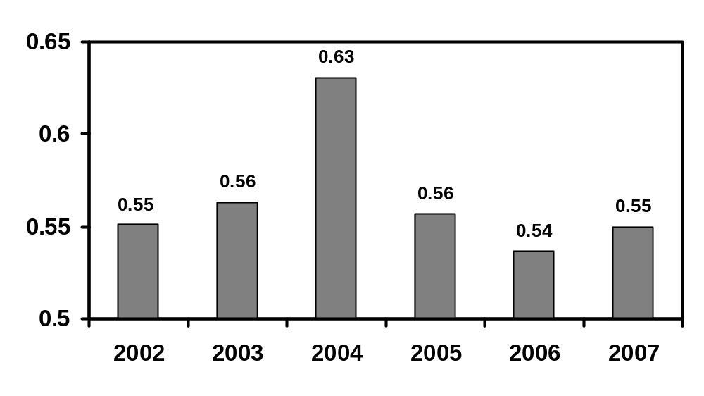
MR

Slide 46
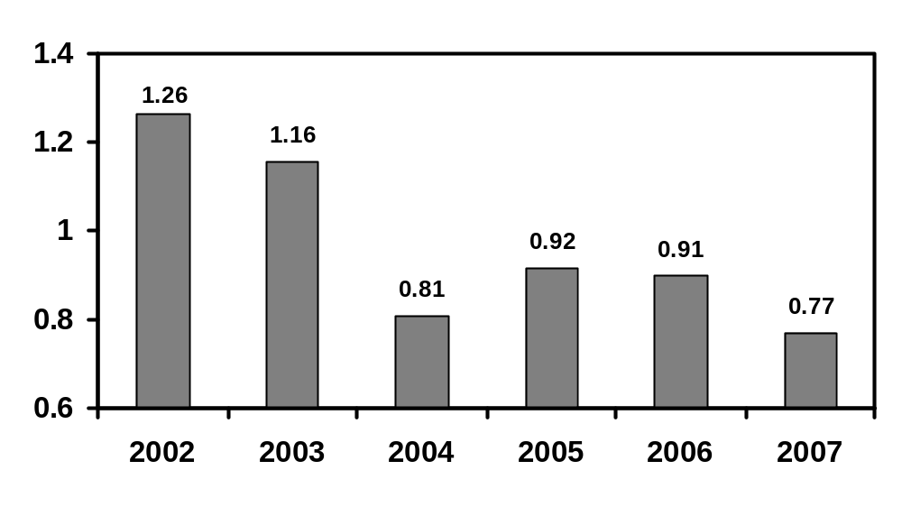
BIAS

Slide 47
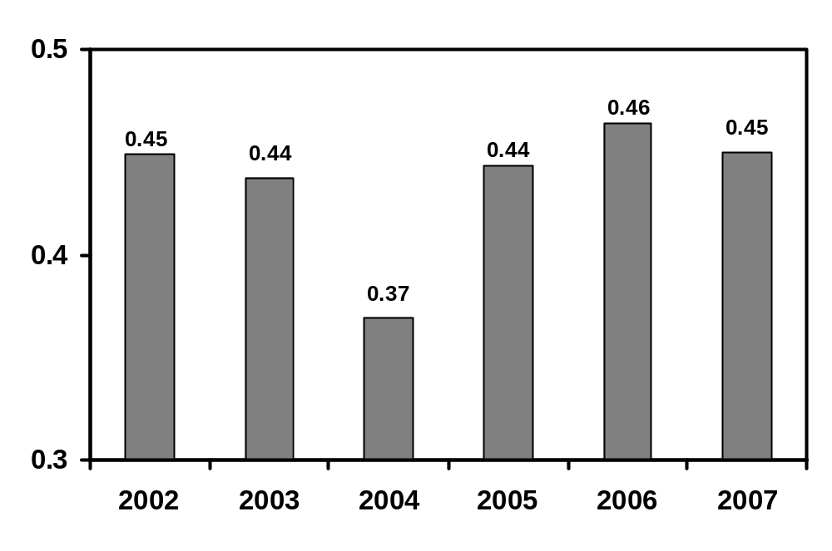
POD

Slide 48
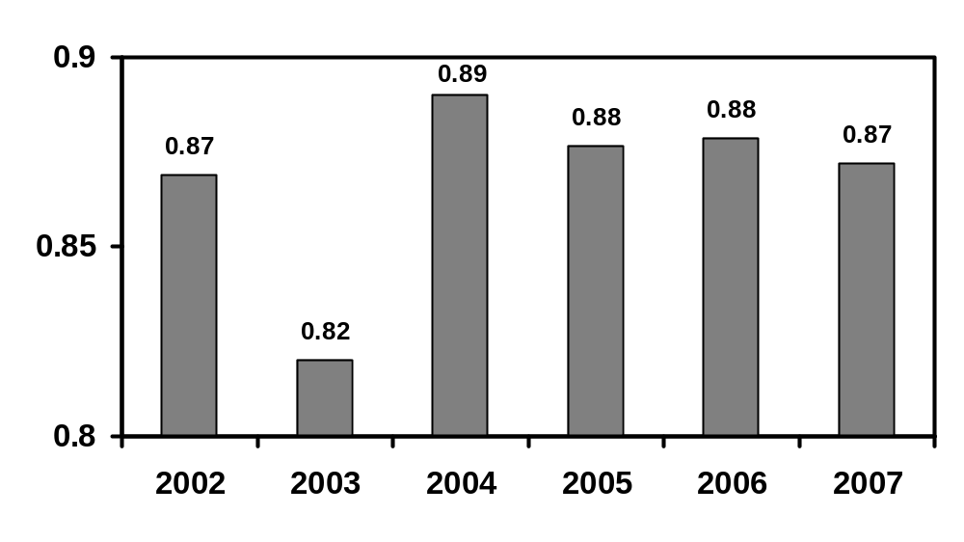
C-NON

Slide 49
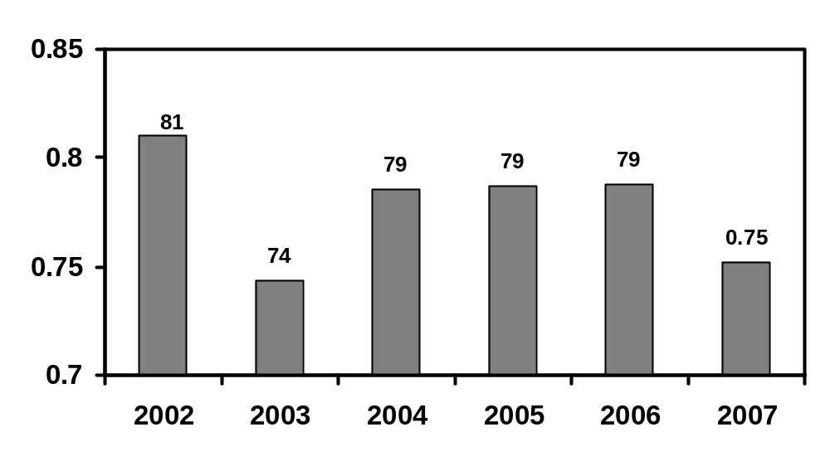
PC

Slide 50
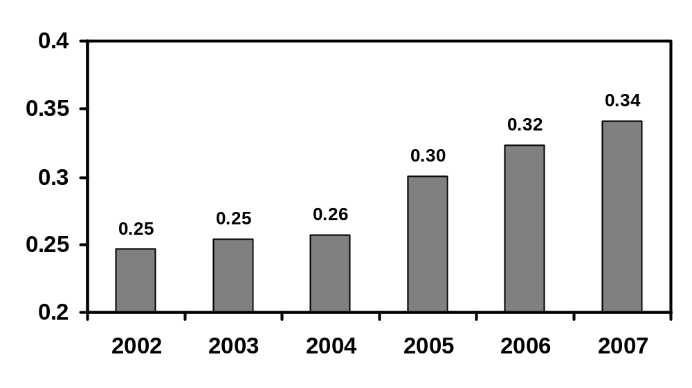
CSI

Slide 51
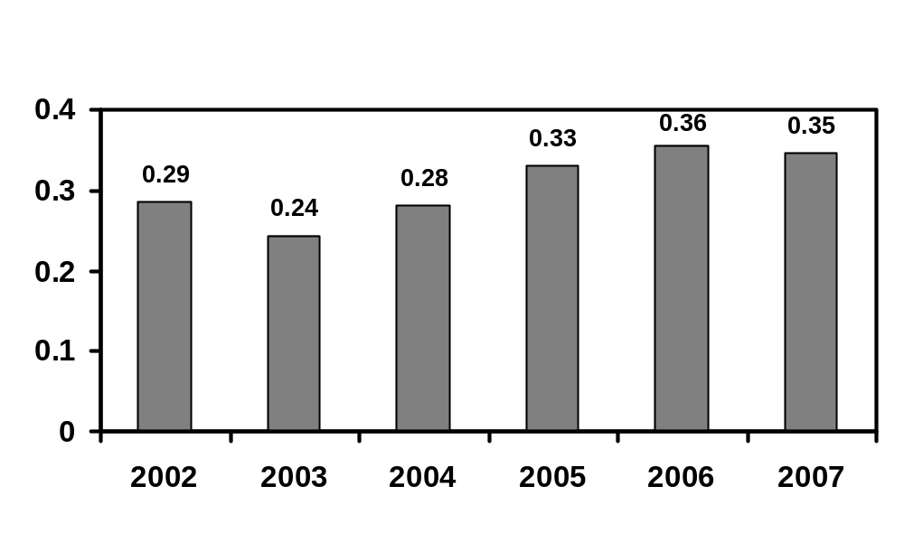
HSS

Slide 52
ALL INDIA VERIFICATION SCORES
(SEASON AS A WHOLE)
POD 0.43
C-NON 0.91
PC 78%
FAR 0.56
MR 0.57
BIAS 0.87
CSI 0.26
HSS 0.30

Slide 53
THE PROBABILITY OF DETECTION OF HEAVY RAINFALL SHOWS INCREASING TREND ALONG WITH DECREASING TRENDS IN MISSING RATES AND FAR IN RECENT YEARS.
THERE IS INCREASE IN THE CSI AND HSS IN RECENT YEARS.
HOWEVER, DUE TO THE SUBJECTIVITY INVOLVED IN THE INTERPRETATION OF NWP MODEL OUTPUTS, THE HEAVY RAINFALL EVENTS COULD NOT BE PREDICTED WITH APPRECIABLE ACCURACY AS POD IS STILL LESS THAN 0.50 WITH HIGHER FAR AND MR.
THE BETTER SKILL OF HEAVY RAINFALL WARNING CAN BE ACHIEVED BY IMPROVING THE QUALITY OF THE NWP MODELS THROUGH BETTER MODEL RESOLUTION, DATA ASSIMILATION AND BY STATISTICAL INTERPRETATION OF THE NWP MODEL OUTPUTS BY OBJECTIVE LINKING OF FORECAST WITH REALISED RAINFALL.

Slide 54
CONCLUSIONS
VERIFICATION OF FORECASTS AND WARNINGS ARE ESSENTIAL TO MONITOR QUALITY AND TO FIND OUT LIMITATIONS OF CURRENT FORECAST SYSTEM. IT IS ALSO REQUIRED TO FURTHER IMPROVE UPON THE FORECAST SYSTEM.
FOR THE ABOVE PURPOSE, WE MUST USE LATEST AVAILABLE OBJECTIVE STATISTICAL TOOLS/ METHODS

Slide 55
References
Jolliffe, I. T. and Stephenson, D. B., 2003, Forecast verification. A practical Guide in Atmospheric Science, Wiley and Sons Ltd, 240 pp.
Murphy, A. H., 1993, What is a good forecast? An essay on the nature of goodness in weather forecasting, Weather Forecasting, 8, 281-293.
Stanski, H. R., Wilsman, L. J. and Burrows, W. R., 1989, Survey of common verification methods in meteorology, WWW Tech. Rep. 8, WMO/TD No. 358, WMO, Geneva.
Thornes, J. E. and Stephenson, D. B., 2001, How to judge the quality and value of weather forecast products, Meteorological Applications, 8, 307-314
Wilks, D. S., 1995, Statistical Methods in the Atmospheric Sciences, An Introduction, Acad. Press, San Diego, 467 pp.

Slide 56
THANK YOU

